Slide 1
EAGLE Pride
BEST Academy at
The Thomas W. Dortch Jr. Institute
Robert Williams, Principal

Slide 2
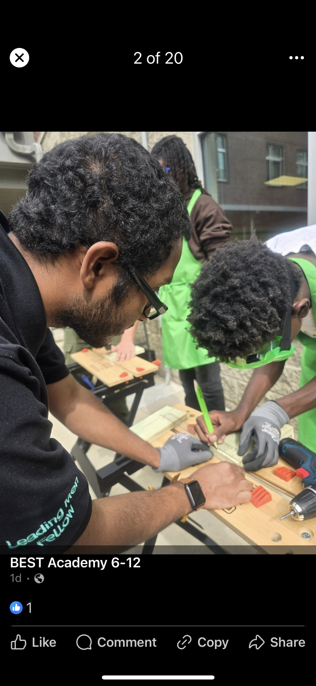
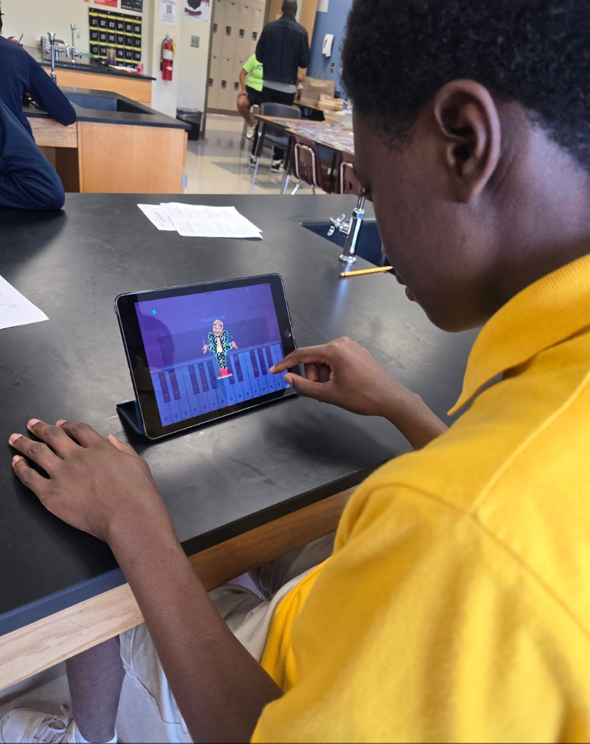
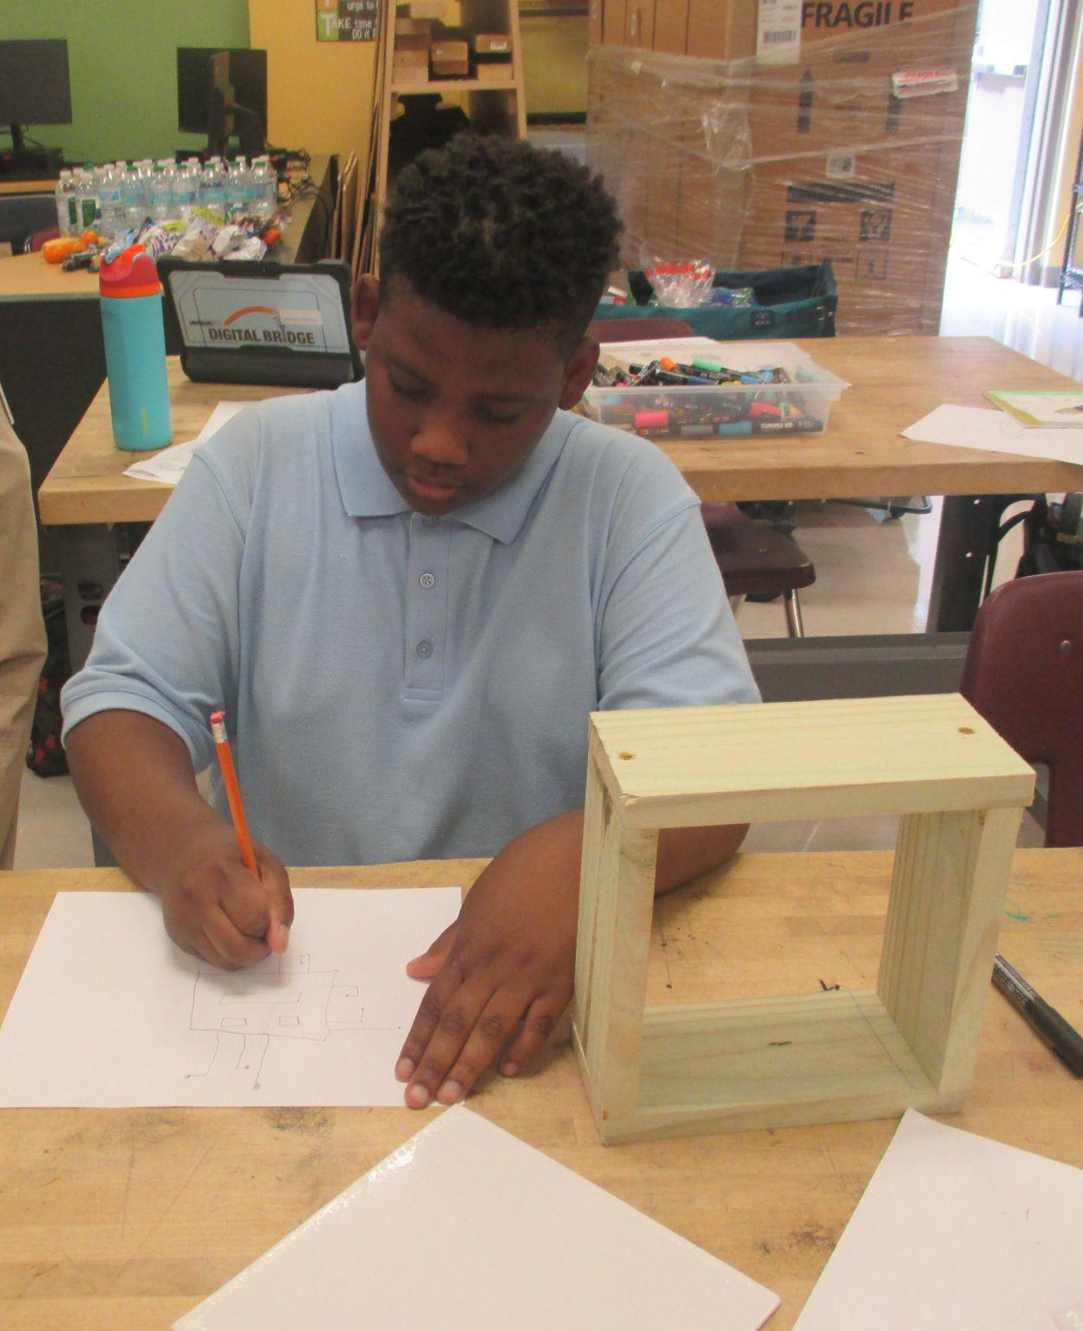
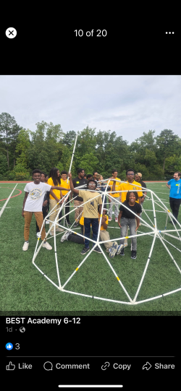
STE(A)M Truck 9-5-24
On September 5th -6th, BEST Middle School welcomed the STE(A)M Truck, offering students hands-on experiences in science, technology, engineering, arts, and mathematics. The event featured rotating stations such as Woodcutting, Rockets, Makey-Makey, Geo Dome, Maze & Coding, Virtual Clean, and Make Music Count + Subsume. Led by STEM Coordinator Mrs. G. Walker, the initiative aimed to enrich students' understanding of the engineering processes in communities with limited access to such resources.

Slide 3
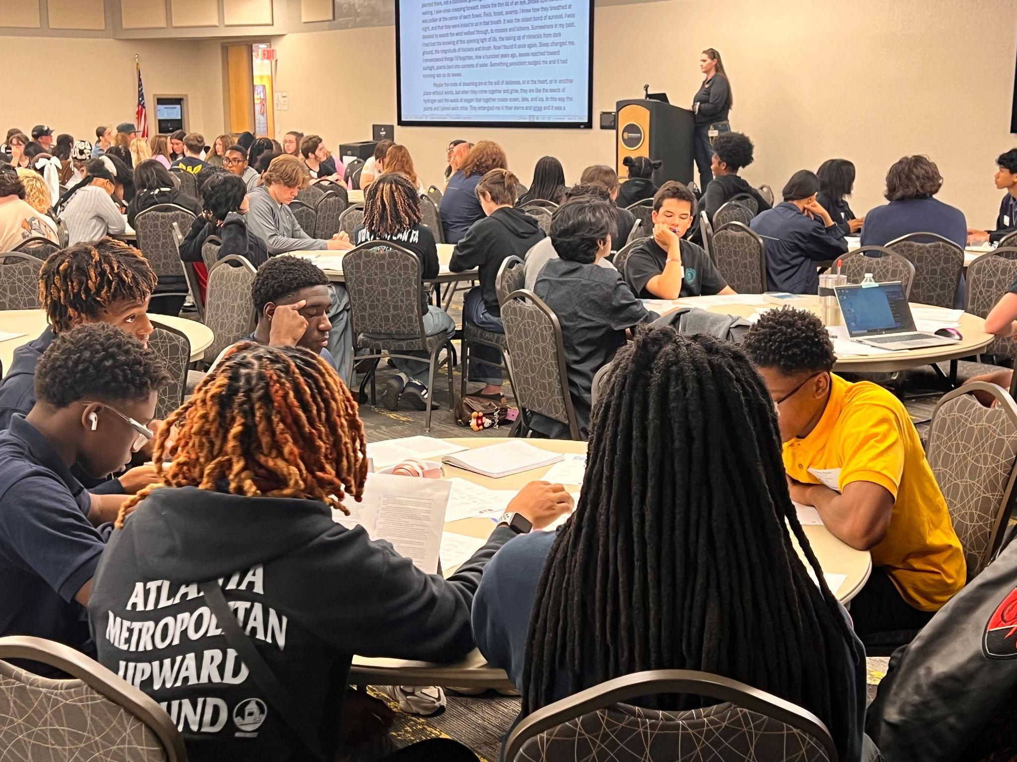
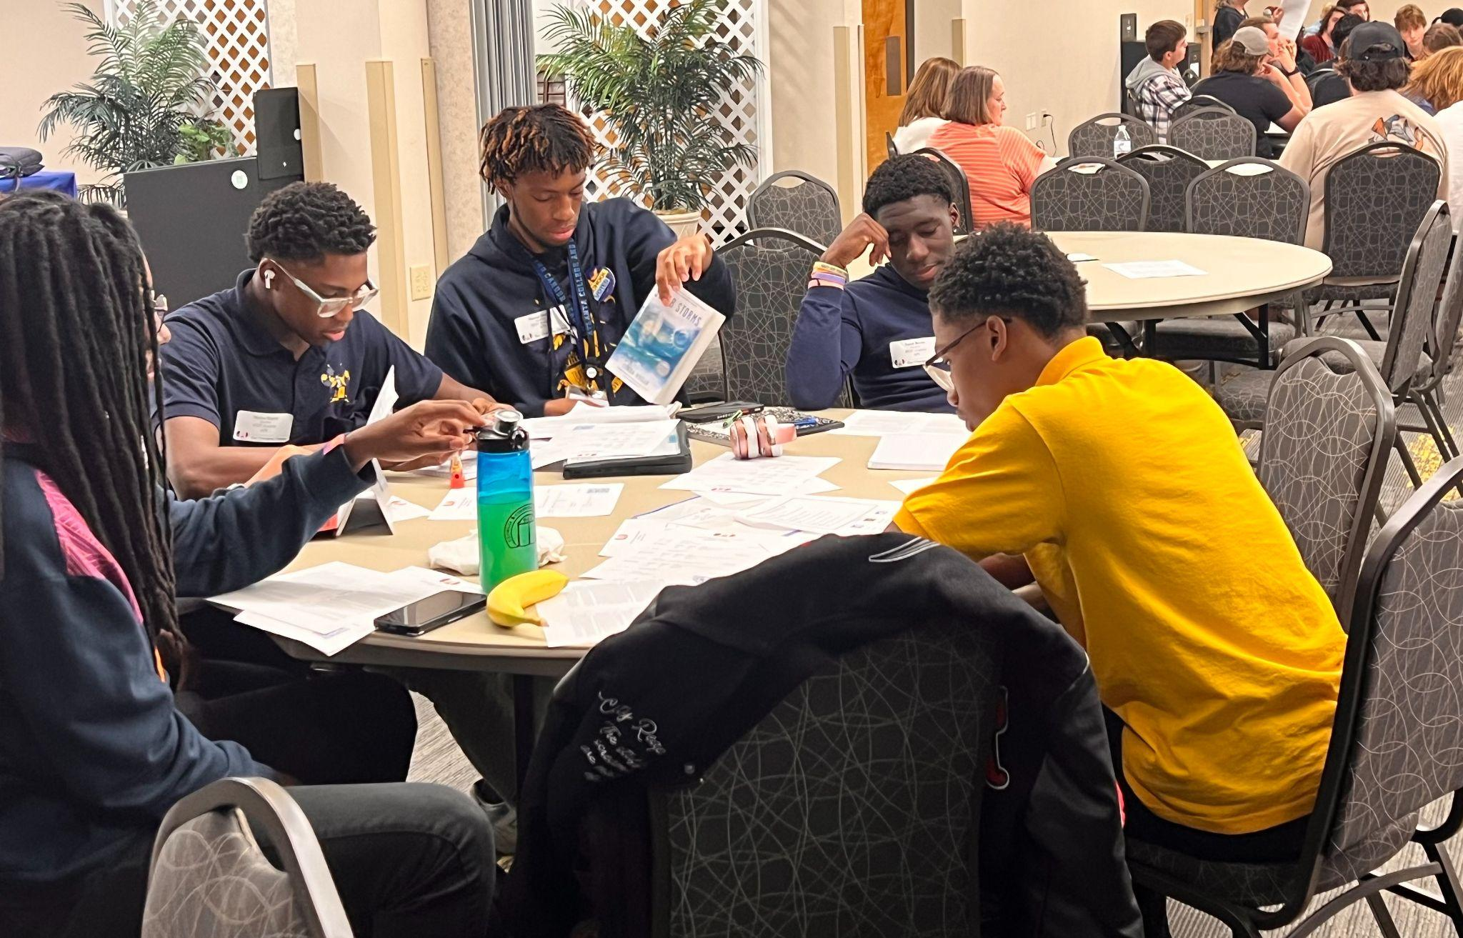
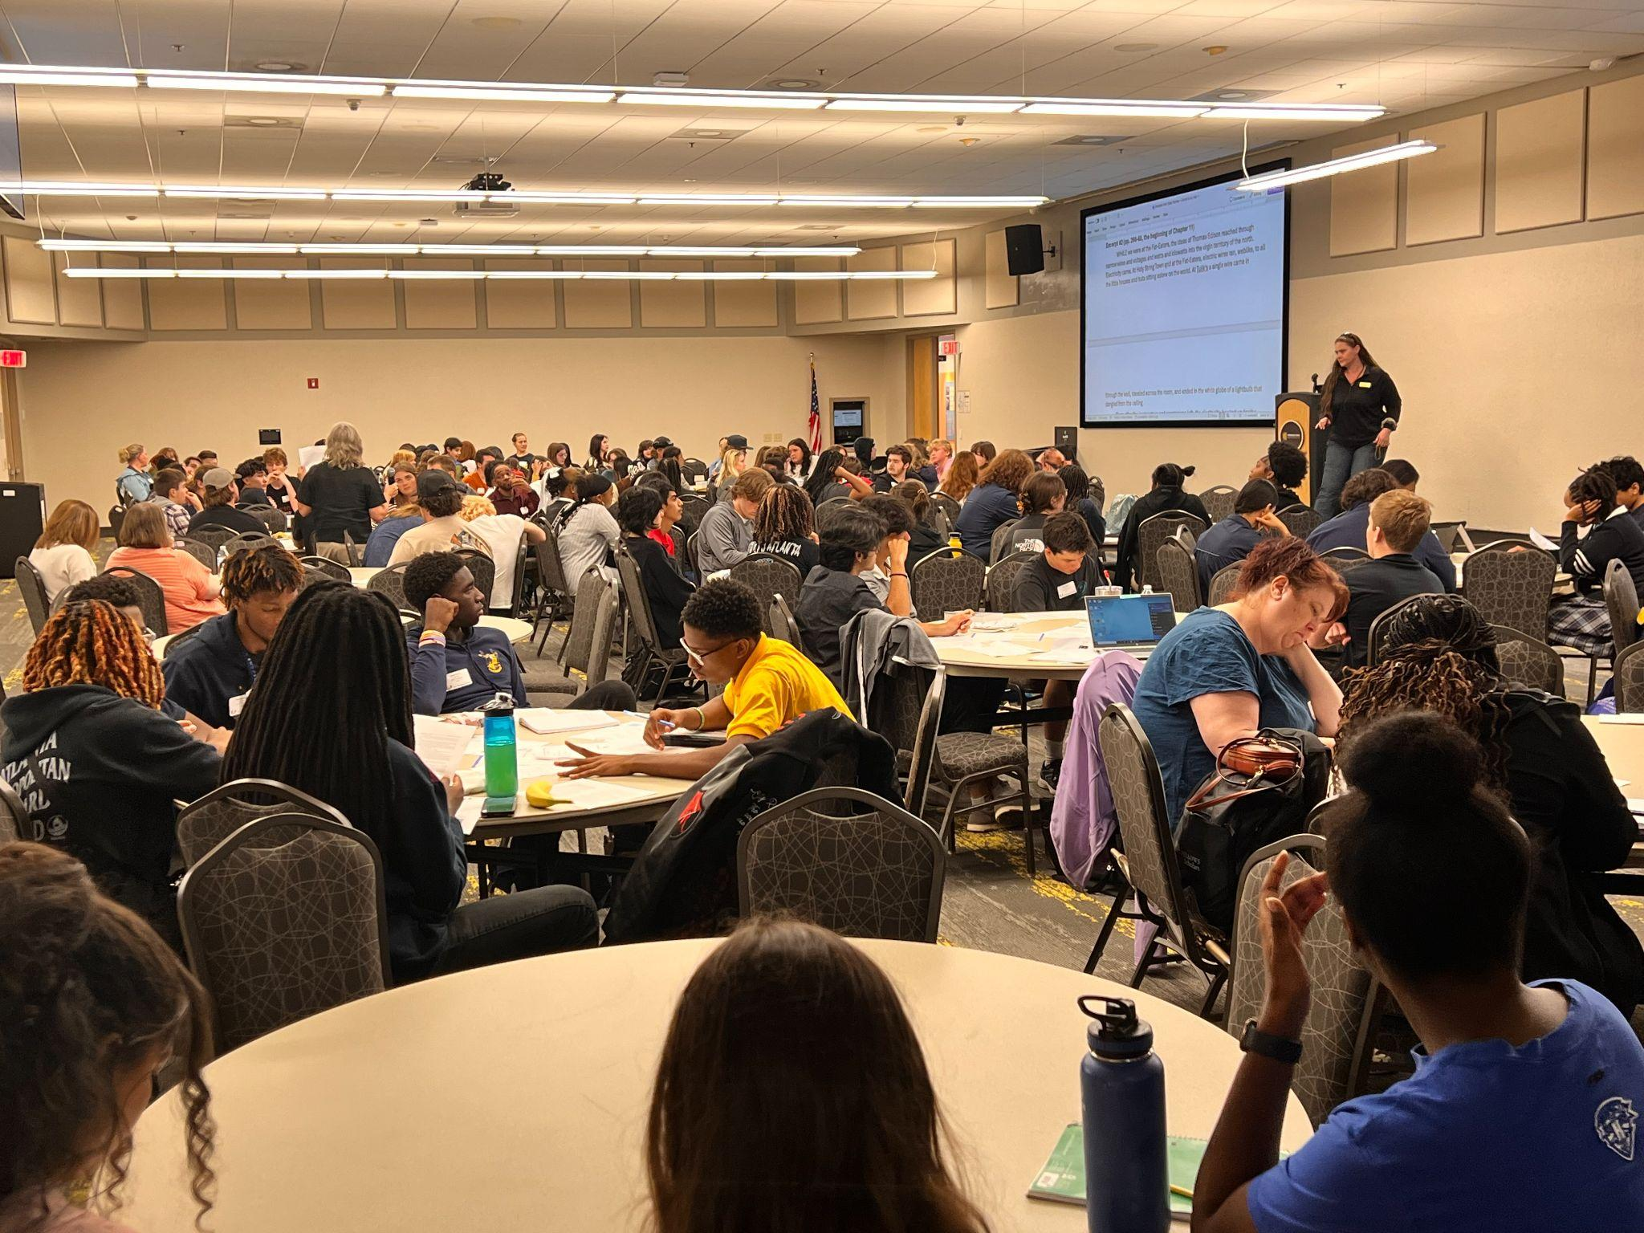
Georgia Academic Decathlon
On Friday, September 13th, BEST Academic Decathlon scholars participated in the PAGE Georgia Academic Decathlon Fall 2024 Workshop at Kennesaw State University. Students engaged in breakout sessions covering ART, ECONOMICS, LITERATURE, MATHEMATICS, MUSIC, SCIENCE, and SOCIAL SCIENCE.
Attendees included Isaiah Brown, Marcus Daniels, Aiden Goforth, Marcus Majette, Maryio Majette, and DeMari Mosle, with sponsorship from Mrs. Quandra Adams and Dr. Bruce Williams.

Slide 4
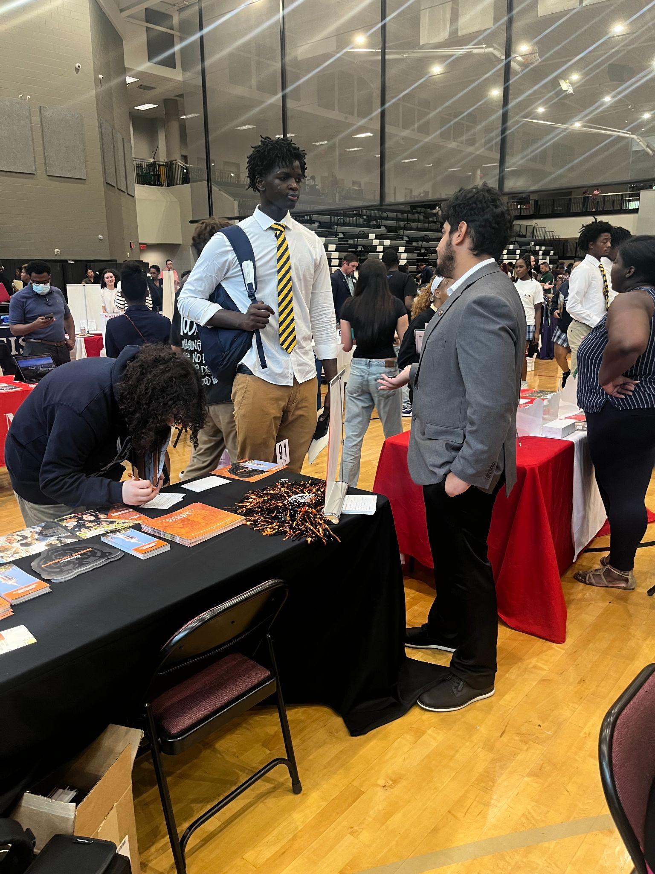
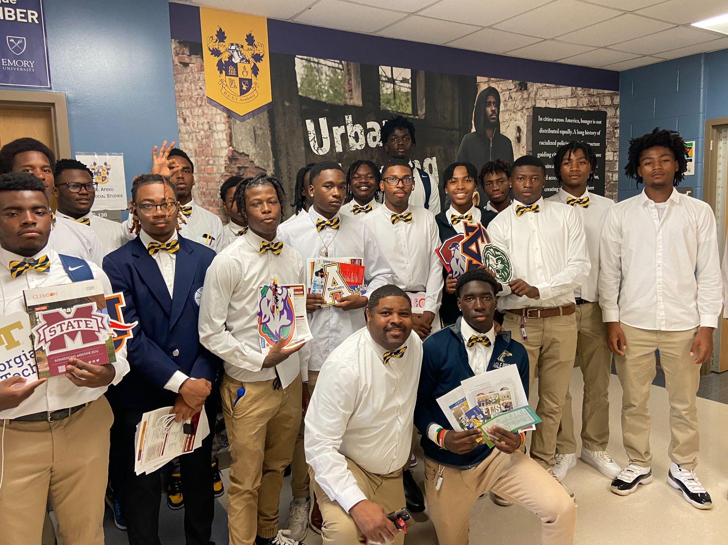
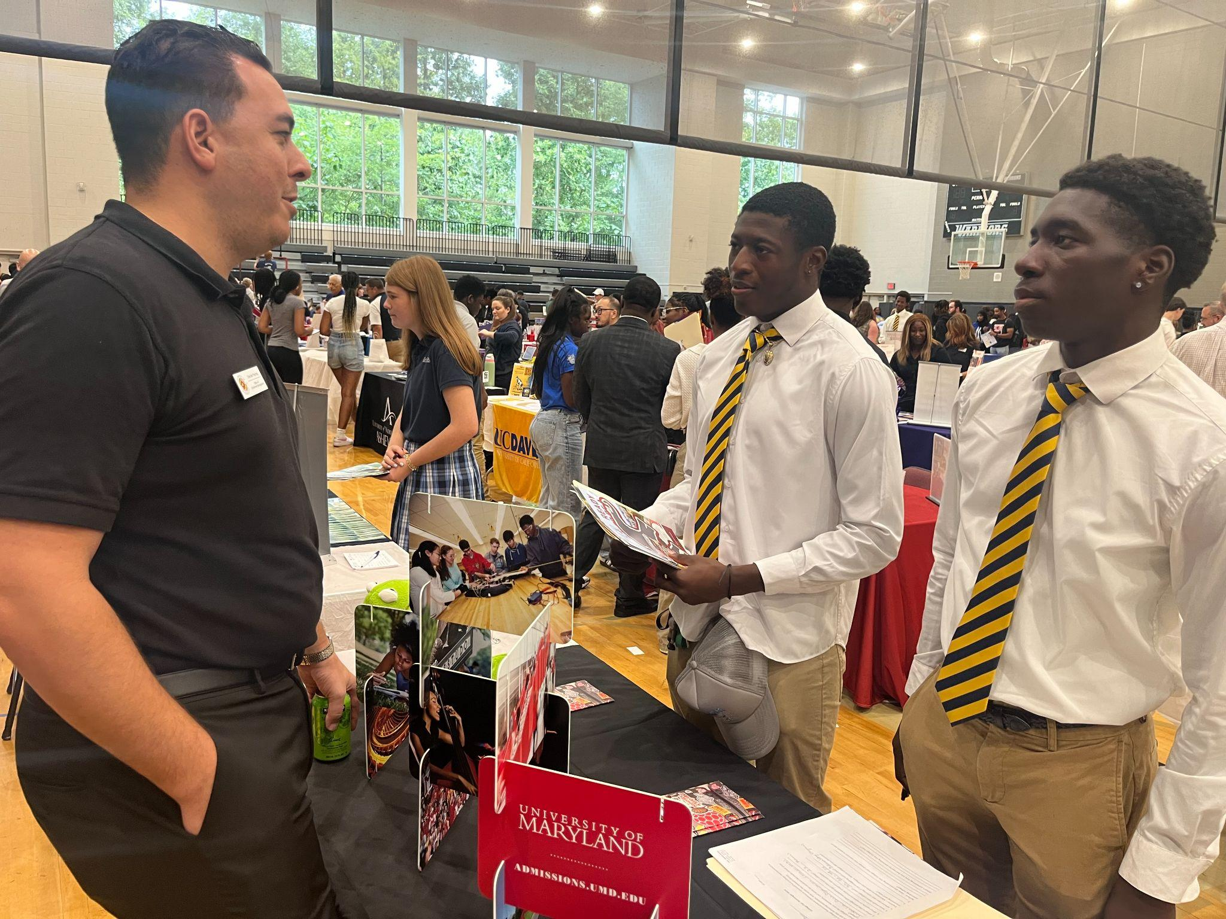
Seniors Attend NAHS/PROBE College Fairs
Seniors from our school recently attended the NAHS/PROBE College Fairs, connecting with college recruiters and discussing their academic futures. Several students engaged in meaningful conversations and received scholarships on the spot!
School counselor McArthur Randolph facilitated the event, guiding students through the college exploration process. This experience offered valuable insights into potential colleges and opened doors for exciting scholarship opportunities.
Fallou Dioum takes a moment to chat with a college representative
Capturing a special moment with MacArthur Randolph, our dedicated counselor, kneeling with Isiah Brown and fellow seniors.
Engaging conversations! Khylen Harris-Norman and Isiah Brown connecting with a representative from the University of Maryland.

